Slide 1
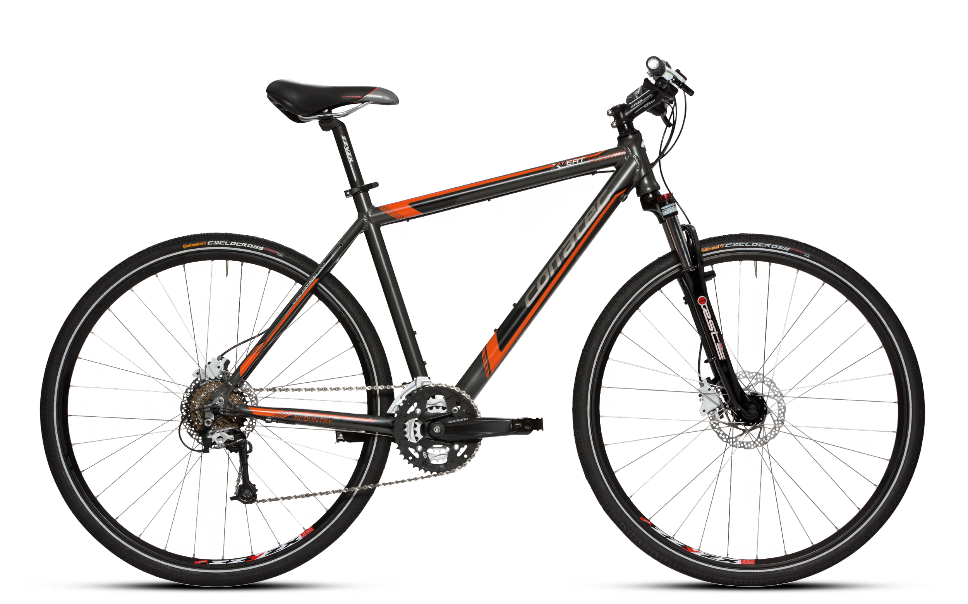
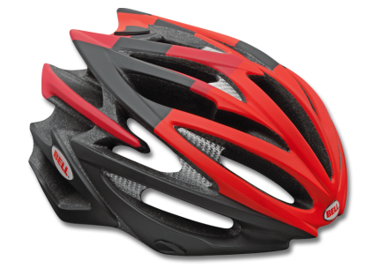
Elevate
A custom built safety helmet for recreational riders with a supported mobile application that supplements the riding experiencing.

Slide 2
Meet the team
Members: Matthew Horger, Kevin Tayah, Jake Rauchen
Group # - 46

Slide 3
Situation
Rider Safety
Recreational Enjoyment (with elevation in particular)
Enhance Riding Experience

Slide 4
Project Scope
Essential - A modular helmet with a supported mobile application that pairs with the helmet
If time permits - Customizable mobile application with more features for users
Out of scope - Corporate connection and field testing for data analysis

Slide 5
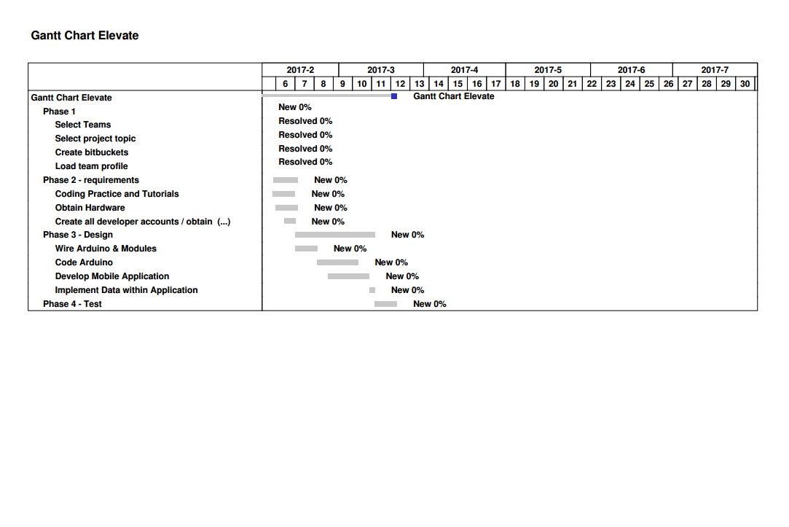
Project Activities

Slide 6
Technological Aspects
Arduino Micro Microprocessor
HC-04 Ultrasonic Modules / GPS Breakout Modules
Android Studio
Google Maps API
Programming Languages
JSON
C++
Java

Slide 7
Challenges
Familiarity with programming languages
Mobile application development
Baselines

Slide 8
Questions?
Thank you for your time and consideration.

